Slide 1

Physics 1
Voronkov Vladimir Vasilyevich

Slide 2
Lecture 3
Work, energy and power
Conservation of energy
Linear momentum.
Collisions.

Slide 3
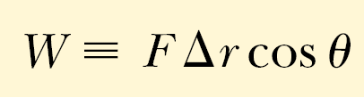
Work
A force acting on an object can do work on the object when the object moves.

Slide 4
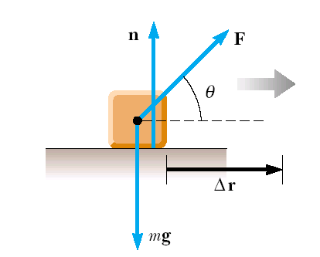
When an object is displaced on a frictionless, horizontal surface, the normal force n and the gravitational force mg do no work on the object. In the situation shown here, F is the only force doing work on the object.

Slide 5
Work Units
Work is a scalar quantity, and its units are force multiplied by length. Therefore, the SI unit of work is the newton • meter (N • m). This combination of units is used so frequently that it has been given a name of its own: the joule ( J).

Slide 6
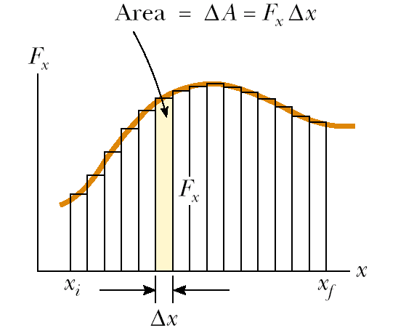

Work done by a varying force

Slide 7
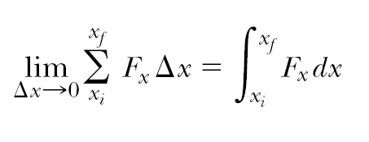
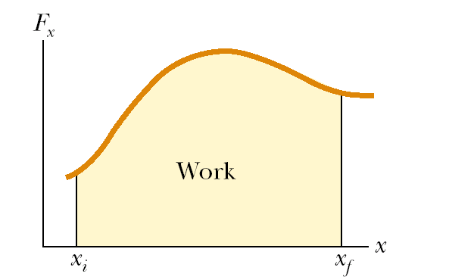
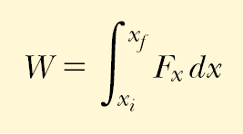

Slide 8
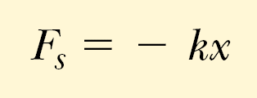
Work done by a spring
If the spring is either stretched or compressed a small distance from its unstretched (equilibrium) configuration, it exerts on the block a force that can be expressed as

Slide 9
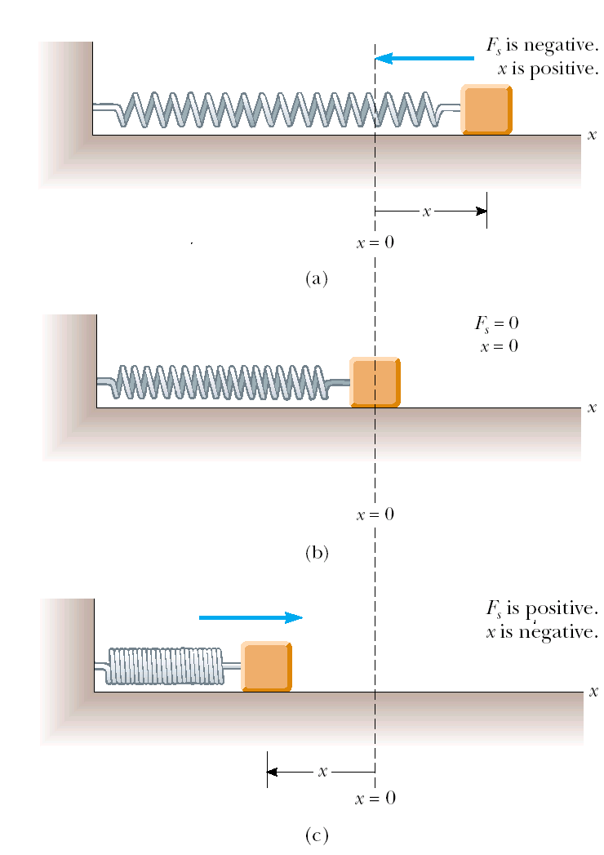

Slide 10
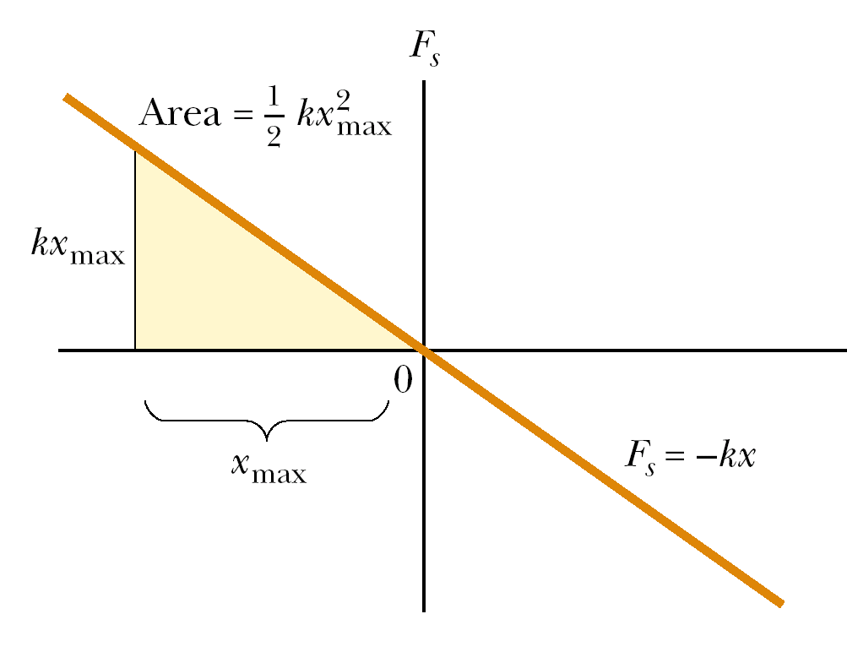

Slide 11
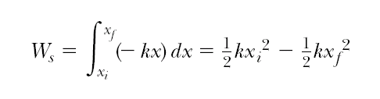
Work of a spring
So, the work done by a spring from one arbitrary position to another is:

Slide 12
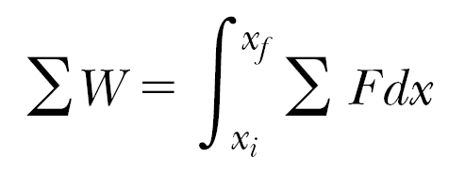

Kinetic energy
Work is a mechanism for transferring energy into a system. One of the possible outcomes of doing work on a system is that the system changes its speed.
Let’s take a body and a force acting upon it:
Using Newton’s second law, we can substitute for the magnitude of the net force
and then perform the following chain-rule manipulations on the integrand:

Slide 13
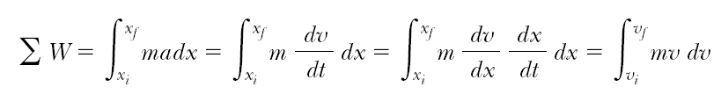
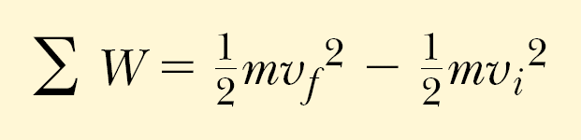
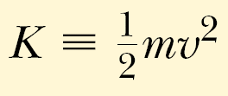
And finally:
This equation was generated for the specific situation of one-dimensional motion, but it is a general result. It tells us that the work done by the net force on a particle of mass m is equal to the difference between the initial and final values of a quantity

Slide 14

Work-energy theorem:
In the case in which work is done on a system and the only change in the system is in its speed, the work done by the net force equals the change in kinetic energy of the system.
This theorem is valid only for the case when there is no friction.

Slide 15
Conservative and Nonconcervative Forces
Forces for which the work is independent of the path are called conservative forces.
Forces for which the work depends on the path are called nonconservative forces
The work done by a conservative force in moving an object along any closed path is zero.

Slide 16
Examples
Conservative Forces:
  Spring
  central forces
    Gravity
    Electrostatic forces
Nonconcervative Forces:
  Various kinds of Friction

Slide 17
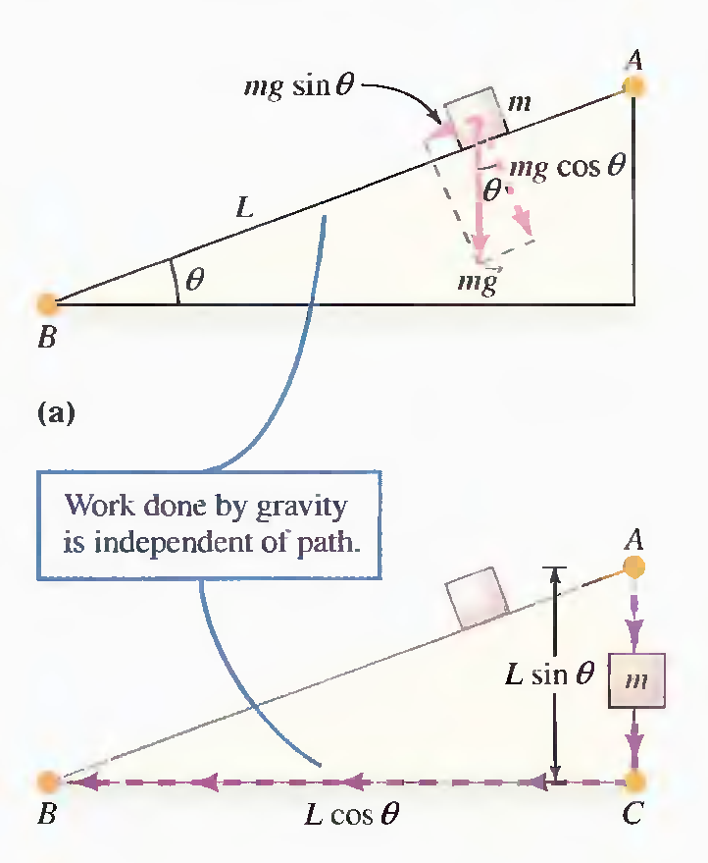
Gravity is a conservative force:
An object of moves from point A to point B on an inclined plane under the intluence of gravity. Gravity does positive (or negative) work on the object as it move down (or up) the plane.
The object now moves from point A to point B by a different path: a vertical motion from point A to point C followed by a horizontal movement from C to B. The work done by gravity is exactly the same as in part (a).

Slide 18
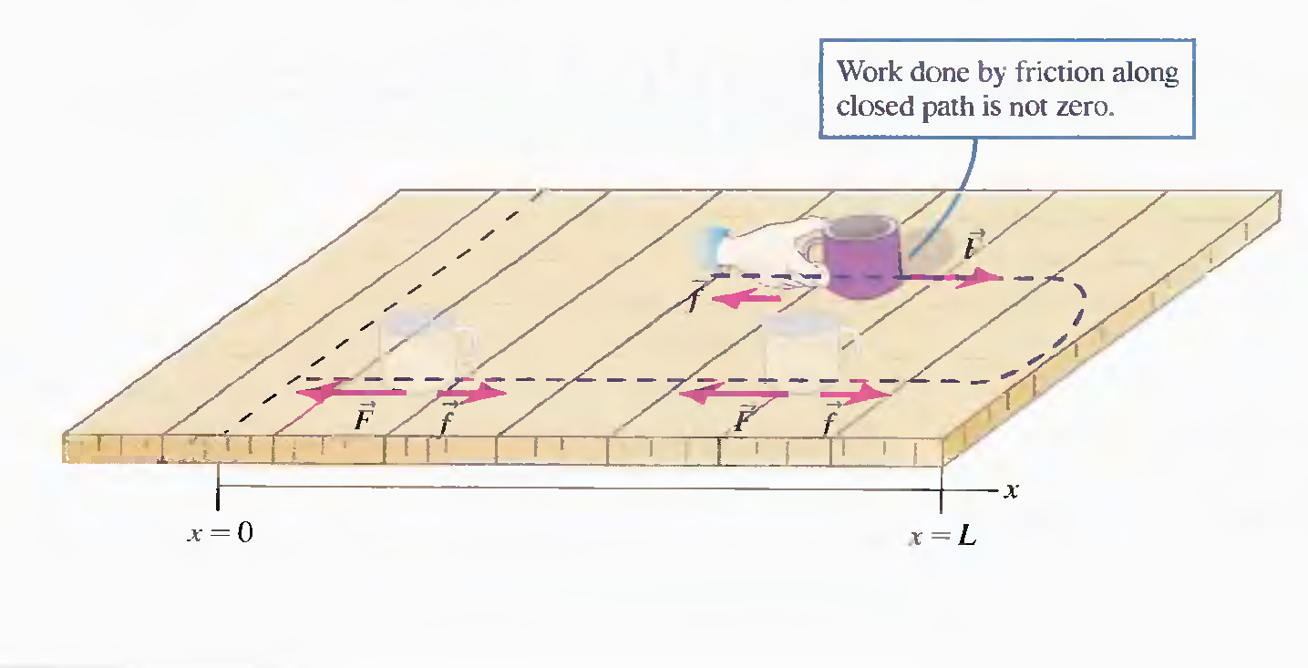
Friction is a nonconcervative force:

Slide 19
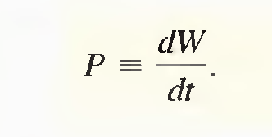
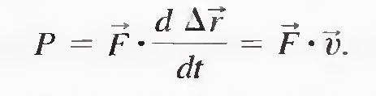
Power
Power P is the rate at which work is done:

Slide 20
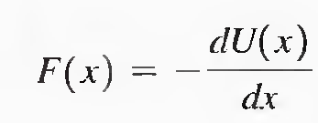
Potential Energy
Potential energy is the energy possessed by a system by virtue of position or condition.
We call the particular function U for any given conservative force the potential energy for that force.
Remember the minus in the formula above.

Slide 21
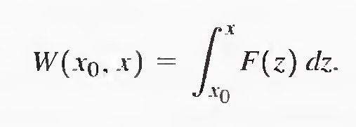

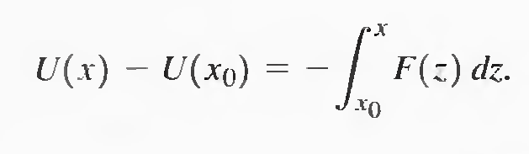

Slide 22
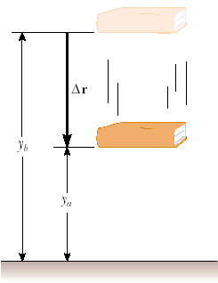






Potential Energy of Gravity

Slide 23
Conservation of mechanical energy
E = K + U(x) = ½ mv² + U(x) is called total mechanical energy
If a system is
  isolated (no energy transfer across its boundaries)
  having no nonconservative forces within
then the mechanical energy of such a system is constant.

Slide 24


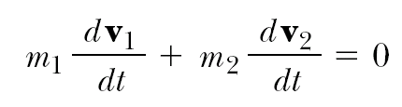
Linear momentum
Let’s consider two interacting particles:
and their accelerations are:
using definition of acceleration:
masses are constant:

Slide 25
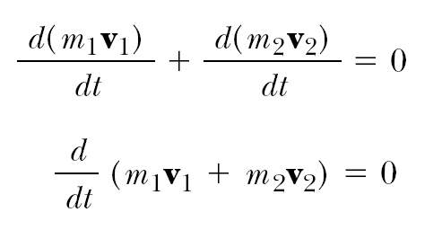

So the total sum of quantities mv for an isolated system is conserved – independent of time.
This quantity is called linear momentum.

Slide 26
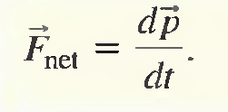
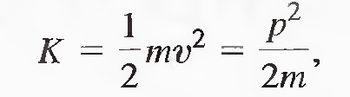
General form for Newton’s second law:
It means that the time rate of change of the linear momentum of a particle is equal to the net for force acting on the particle.
The kinetic energy of an object can also be expressed in terms of the momentum:

Slide 27
The law of linear momentum conservation
The sum of the linear momenta of an isolated system of objects is a constant, no matter what forces act between the objects making up the system.

Slide 28
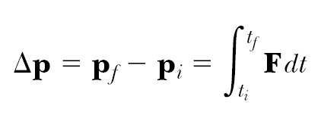
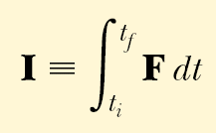
Impulse-momentum theorem
The impulse of the force F acting on a particle equals the change in the momentum of the particle.
Quantity is called the impulse of the force F.

Slide 29
Collisions
Let’s study the following types of collisions:
Perfectly elastic collisions:
  no mass transfer from one object to another
  Kinetic energy conserves (all the kinetic energy before collision goes to the kinetic energy after collision)
Perfectly inelastic collisions: two objects merge into one. Maximum kinetic loss.

Slide 30




Perfectly elastic collisions
We can write momentum and energy conservation equations:
(1)
(2)
(1)=> (3)
(2)=> (4)
(4)/(3): (5)

Slide 31

Denoting
We can obtain from (5)
Here U_{i} and U_{f} are initial and final relative velocities.
So the last equation says that when the collision is elastic, the relative velocity of the colliding objects changes sign but does not change magnitude.

Slide 32


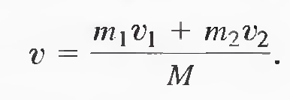
Perfectly inelastic collisions

Slide 33
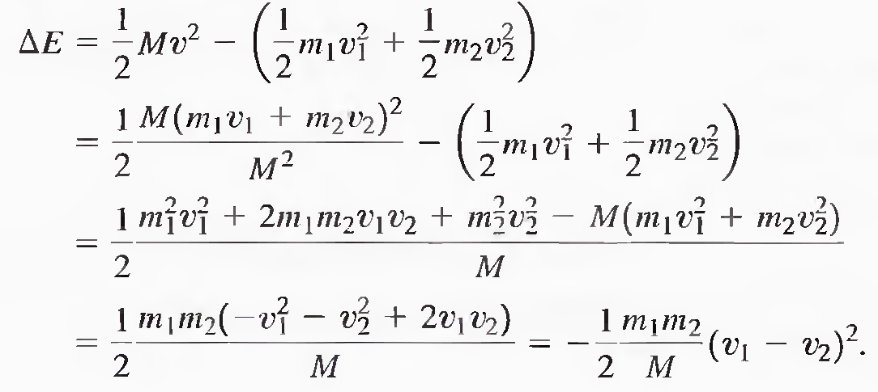
Energy loss in perfectly inelastic collisions

Slide 34
Units in SI
Work,Energy W,E J=N*m=kg*m²/s²
Power P J/s=kg*m²/s³
Linear momentum p kg*m/s

